Slide 1
Patient safety and technology
Introduction to medical informatics
IM 2017

Slide 2
Learning Objectives
Identify why patient safety is a national concern
List the perceived causes of patient safety concerns
Describe the role of information technology in improving patient safety
Compare and contrast the private and governmental patient safety programs
List the various technologies that are likely to improve medication error rates such as computerized physician order entry
Identify the obstacles to widespread implementation of patient safety initiatives

Slide 3
Background
Technology can improve the quality of medical care
Improved quality of care means improved patient safety
Technology can therefore improve patient safety

Slide 4
Let’s Define Patient Safety and Informatics
Patient safety is “the environment, infrastructure and technology emphasizing the reporting, analysis and prevention of medical error and adverse events that might case a patient ‘harm’ “.
Informatics is “the application of computing technology, network protocols, telecommunication mechanism and software algorithms applied towards improving the quality of a “Human Service” process”

Slide 5
Patient Safety might Encompass:
Patient fall
Medication errors
Identification errors
Suicide
Infection
Patient protection from bodily harm
Post / op complications
Treatment delays
Adverse drug effects
Many others coming out every day

Slide 6
US spends a greater percent of their gross national product (GNP)

Slide 7
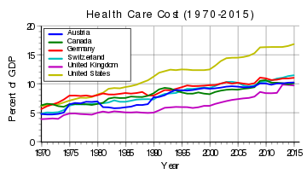

Slide 8
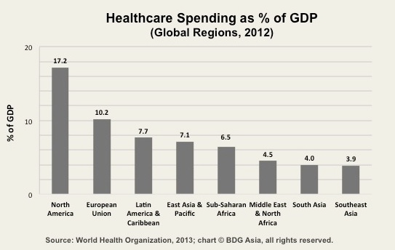

Slide 9
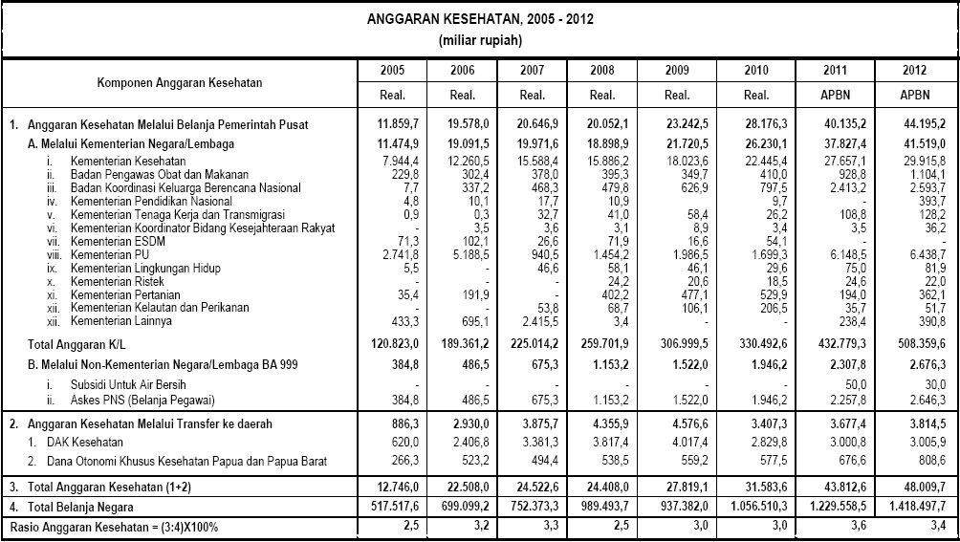

Slide 10
Basic Statistics
Projected from a report from the Institute of Medicine in 1999 I estimate (using some statistical inferences) that as many as 140,000 people die in U.S. hospitals each year as the result of lapses in patient safety.
Over past 5 years over 125,000 medication errors have been reported to FDA (Just one agency )
Imagine, how many might have not been reported?
Imagine, how many might have not been reported because non-identification of errors?

Slide 11
IOM (Institute of Medicine)
Commented on three categories of medical errors
Overuse: widespread use of antibiotics for viral infections; 32% of carotid artery surgeries were clearly inappropriate and 32% were equivocal
Underuse: vaccines, cancer screening, beta blockers post heart attack, etc.
Misuse: 36% of patients with active tuberculosis were not treated with four drugs initially, as recommended
Rand Study 2003 : Some have argued that one of the causes of decreased patient safety is the failure of US physicians to follow national clinical practice guidelines.
Institute of Medicine (IOM) Reports: at least 98,000 inpatients die every year and 1,000,000 are injured due to preventable errors

Slide 12
HealthGrades 2008 Hospital Quality in America Study
Post operative sepsis (severe infection)
Post-operative respiratory failure
Decubitus ulcers (bed sores)
Post-operative pulmonary emboli or DVTs (blood clots)
Hospital acquired infections
Failure to rescue (not recognizing and treating a deteriorating patient)

Slide 13
Why is the USA Healthcare report card unfavorable?
The growing complexity of science and technology
The increase in chronic conditions, e.g. obesity, diabetes and heart failure
Poorly organized delivery systems that are not organized around patient safety
The constraints on exploiting the revolution in information technology
Medical error rates are too high
Healthcare quality is inconsistent
Medical research results are not rapidly used
Healthcare costs are escalating
New technologies continue to drive up costs
Baby boomers will greatly increase demand
The capacity for early detection of bioterrorism is minimal

Slide 14
Barriers to Improving Patient Safety through Technology
Organizational
Financial
Trained HIT Workforce
Privacy
Security
Behavioral
Error reporting

Slide 15
What is the Federal Government doing about patient safety?
Agency for Healthcare Research and Quality (AHRQ)
Patient Safety and Quality Improvement Act S.544
Centers for Medicare and Medicaid Services (2008)
Objects left in a patient during surgery and blood incompatibility
Catheter-associated urinary tract infections
Pressure ulcers (bed sores)
Vascular catheter-associated infections
Surgical site infections
Serious trauma while hospitalized
Extreme blood sugar derangement
Blood clots in legs or lungs

Slide 16
What are private agencies doing about patient safety?
The Joint Commission
Institute for Healthcare Improvement (IHI)
LeapFrog Group
HealthGrades

Slide 17
Information Technology and Patient Safety
On average, a hospital patient is subject to one medication error per day
The IOM estimates that about 1.5 million preventable ADEs occur yearly with about 400,000 preventable ADEs occurring in inpatients
Estimated cost of $5,857 per inpatient error resulting in about $3.5 billion in 2006 dollars due to longer length of stay and additional services, but excluding litigation
The IOM maintains that estimates are probably low, based on how statistics were collected

Slide 18
“Technology has great potential in reducing medication errors, but it is not a panacea”

Slide 19
How Application of Informatics can help?
Three Basic Classification of Informatics Application in Patient Safety:
Hardware oriented
Software oriented
Predictive model oriented (BI)

Slide 20
Hardware to ensure patient safety-Examples
Patient bracelet
Lightweight, wireless devices which enable nurses to perform safety checks and safely administer bedside medications.
The Hardware, DB and network backbone that distribute real-time access to patient-specific data and evidence-based medical knowledge–so one can make the right decision at the right time.
Bedside dispensing cabinet systems with digital technology to keep track of medication, administration and safety.
The XXX Type Bandage is ideal for controlling arterial bleeding and severe external hemorrhage.
In Near Future – Gentleman we have the technology (Dr. Dey)
Global Network with synchronous treatment protocols (VOIP)
Holographic Image Transportation within and Outside Hospitals
Global Nursing Stations – Outsourced to different countries like India
Automated ergonomic based Motion-Beds to prevent bed sores

Slide 21
Software to ensure patient safety-Examples
Patient response monitoring systems
Risk Monitoring software in gathering data on nursing-sensitive indicators required for submission to any Agency database.
Intelligent Incident Reporting software – Not just for reporting but Decision Support
Software reporting PSIs (Patent safety Indicators ) as proposed by AHRQ (Agency for Healthcare Research and Quality)
In Near Future – (Dr. Dey)
Intelligent – Bilingual – Response Monitoring System – with ‘No response’ message distribution to the next expert station – collaborative healthcare
On-line real-time risk monitoring software producing “leading indicators” for ensuring patient safety – proactive not reactive

Slide 22
Technologies That Have the Potential to Decrease Medication Errors
Computerized Physician Order Entry: inpatient, out-patient, CDS, and accurate drug histories.
Automated Inpatient Medication Dispensing Devices
Home electronic medication management systems
Pharmacy Dispensing Robots
Electronic Medication Administration Record (eMAR)
Smart” Intravenous (IV) Infusion Pumps
Calculators
Bar coding and Radio Frequency Identification (RFID)
Medication Reconciliation
Electronic Prescribing

Slide 23
Predictive models to ensure patient safety-Examples
Correlations of environmental variables with patient safety violation incidences – 3^{rd,} 6th and 12th Floors
Regression analysis to predict what independent variables can explain the variances in patient safety violations – Language, age, Disease Type, English instructions to non-English speaking patients, primary physicians etc.
Predictive analysis based on patient demographics so that we can be more careful to “High risk” patients (multivariate and data mining ).
Pattern Recognition Algorithms to recognize “leading Indicators” of safety.
Structural equation modeling, sometimes called path analysis, to gain additional insight into causes of “Safety Violations” – if you know the cause you can prevent it.

Slide 24
Key Points
Patient safety is a major issue facing US Medicine today. Far too many people die from medical errors each year
There is great hope that information technology, particularly clinical decision support as part of the electronic health record, will improve patient care and safety
There is some evidence that clinical decision support and alerts may reduce medication errors
Bar code medical administration also appears to reduce some medication related errors but is expensive and complicated
Any modality that will reduce deadly intravenous drug errors, such as smart infusion pumps, makes sense
A dedicated and focused patient safety strategy must accompany any deployment of information technology

